Slide 1

CS 7180: Geometric Deep Learning
Lecture 2: Review of Deep Learning
Image credit: Michael Bronstein

Slide 2
The Supervised Machine Learning Setting

Slide 3
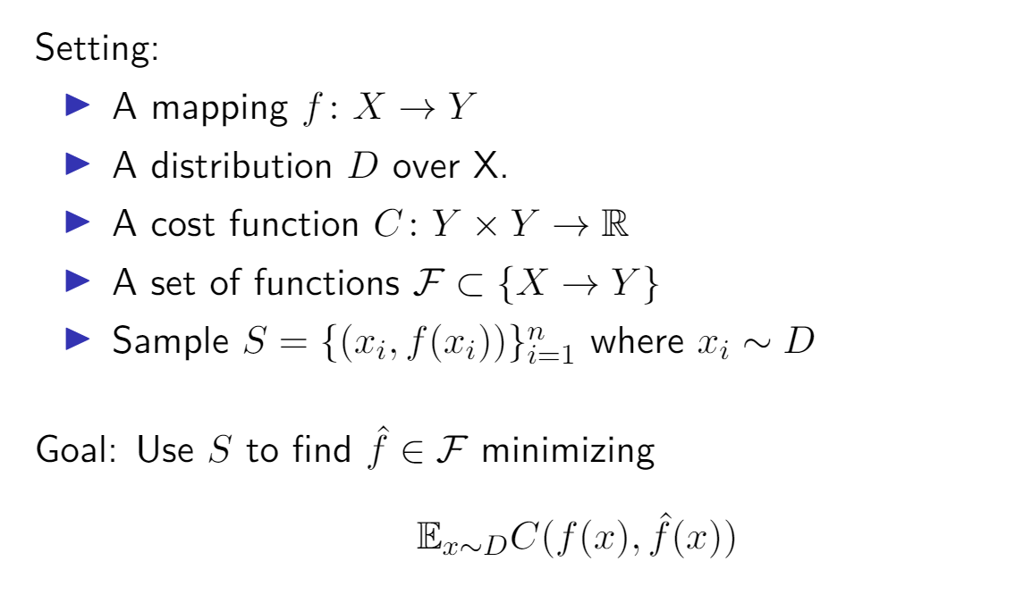
Supervised Machine Learning
Machine learning is often a type of function fitting.

Slide 4
Supervised Machine Learning
Machine learning is often a type of function fitting.

Slide 5
Supervised Machine Learning
Machine learning is often a type of function fitting.

Slide 6
Supervised Machine Learning
Machine learning is often a type of function fitting.

Slide 7
Supervised Machine Learning
Machine learning is often a type of function fitting.

Slide 8
Supervised Machine Learning
Machine learning is often a type of function fitting.

Slide 9


Supervised Machine Learning

Slide 10




Supervised Machine Learning

Slide 11
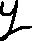

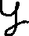
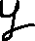



Supervised Machine Learning

Slide 12
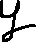
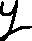

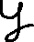

Supervised Machine Learning

Slide 13
Supervised Machine Learning

Slide 14
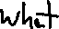
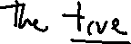
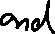
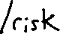
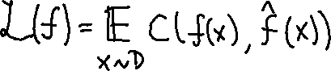
Supervised Machine Learning

Slide 15



Supervised Machine Learning

Slide 16
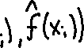
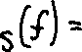
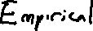
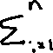
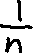
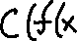

Supervised Machine Learning

Slide 17
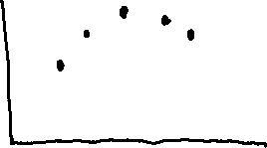
Overfitting
Minimizing Empirical Error Can Lead to Overfitting

Slide 18
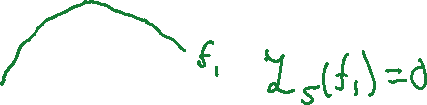
Overfitting
Minimizing Empirical Error Can Lead to Overfitting

Slide 19
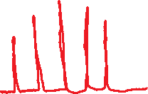
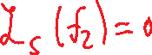
Overfitting
Minimizing Empirical Error Can Lead to Overfitting

Slide 20
Overfitting
Minimizing Empirical Error Can Lead to Overfitting
How to prevent overfitting?

Slide 21
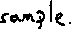
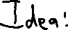

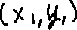
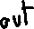
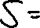
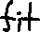
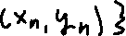
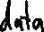
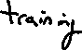
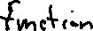
Validation

Slide 22

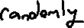
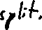
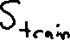
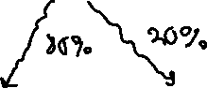
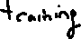
Validation

Slide 23

Validation

Slide 24
Validation

Slide 25
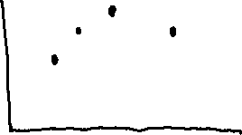
Validation

Slide 26


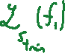
Validation

Slide 27
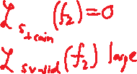
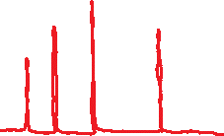
Validation

Slide 28
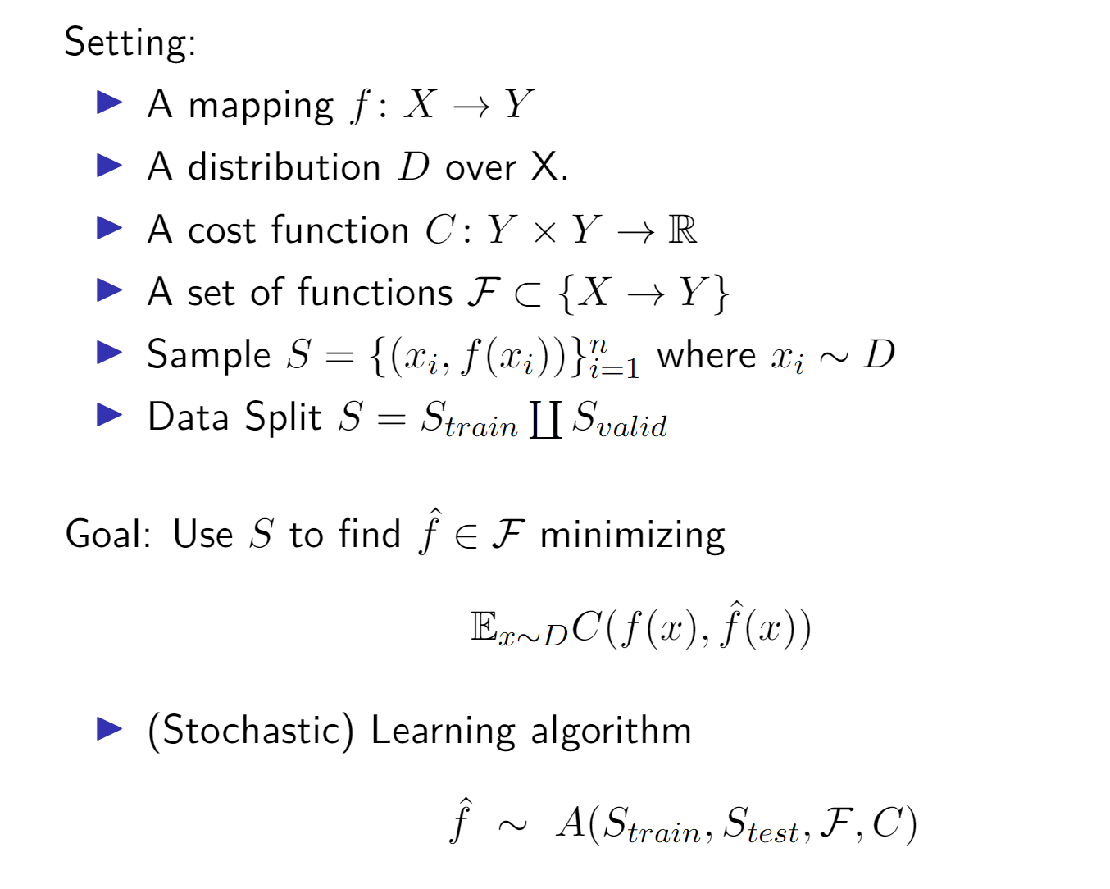
Supervised Machine Learning
Machine learning is often a type of function fitting.

Slide 29
Supervised Machine Learning
Machine learning is often a type of function fitting.

Slide 30
Supervised Machine Learning
Machine learning is often a type of function fitting.

Slide 31

Model Selection
1.5
1
0.5
y
0
Example P(x,y)
−0.5
−1
−1.5
0
10
20
30
40
50
60
70
80
90
100
x

Slide 32
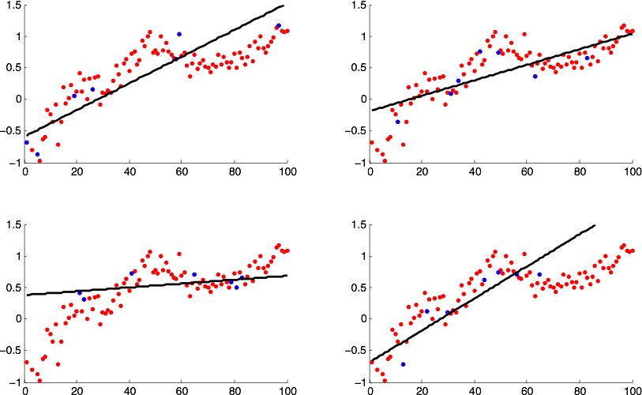
Linear

Slide 33
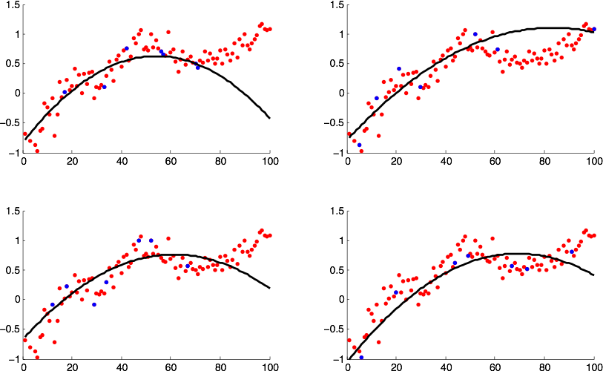
Quadratic

Slide 34

Cubic

Slide 35
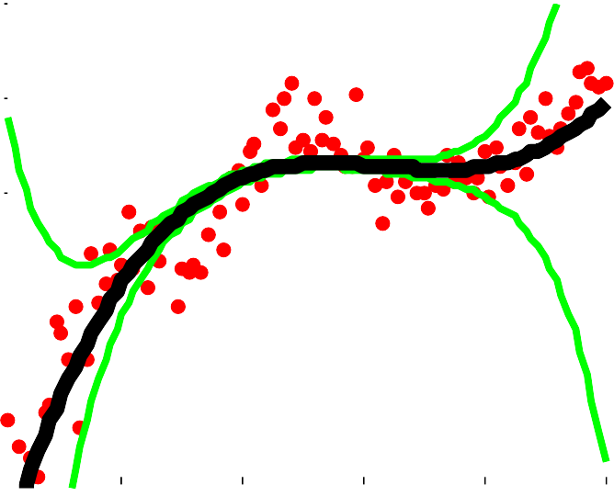
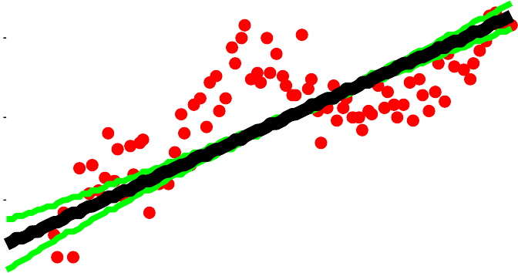
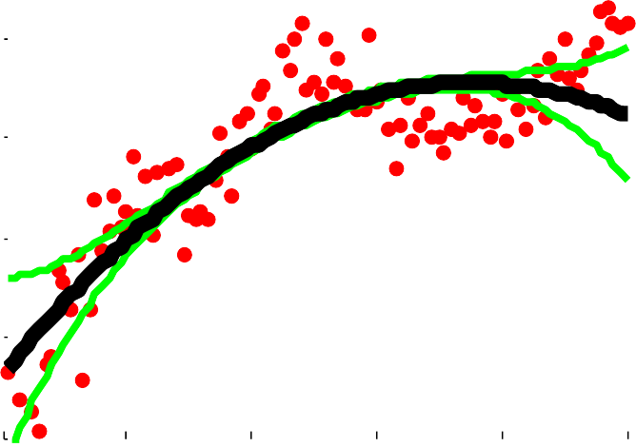









Bias-Variance Trade-off
1.5
1.5
1.5
1
1
1
0.5
0.5
0.5
0
0
0
−0.5
−0.5
−0.5
−1
0
20
40
60
80 100
−1
0
20
40
60
80 100
−1
0
20
40
60
80 100
1.5
Bias
Variance
1.5
Bias
Variance
1.5
Bias
Variance
1
1
1
0.5
0.5
0.5
0
0
20
40
60
80 100
0
0
20
40
60
80 100
0
0
20
40
60
80 10
Depends on Model Class F and learning algorithm A

Slide 36
Supervised Machine Learning
Examples of Tasks and Distributions

Slide 37
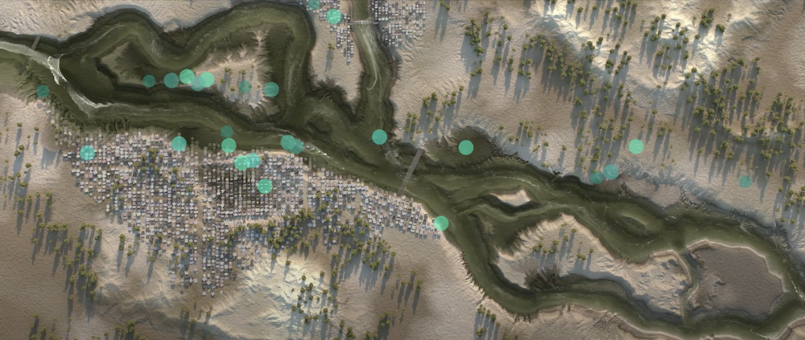
Example: Flood Prediction
Input (x):Rainfall, temperature, river levels, weather forecast, date
Output (y): flood risk in each area
Deployed in India as App which send real-time warnings to people.
https://blog.google/technology/ai/flood-forecasts-india-bangladesh/

Slide 38
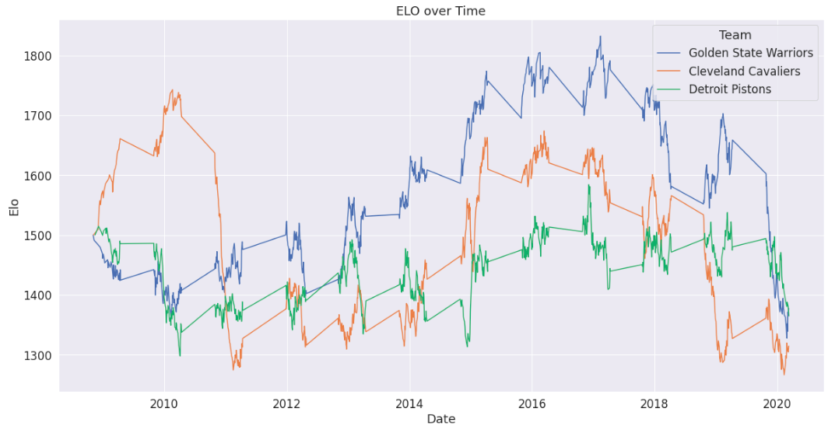
Example: Predict Outcome NBA Games
Input (x):Player statistics for players on both teams, team ratings, W/L, ELO, PER
Output (y): which team wins
Model: Random Forest
Best Model Achieves 74.1% accuracy.
https://towardsdatascience.com/predicting-the-outcome-of-nba-games-with-machine-learning-a810bb768f20

Slide 39
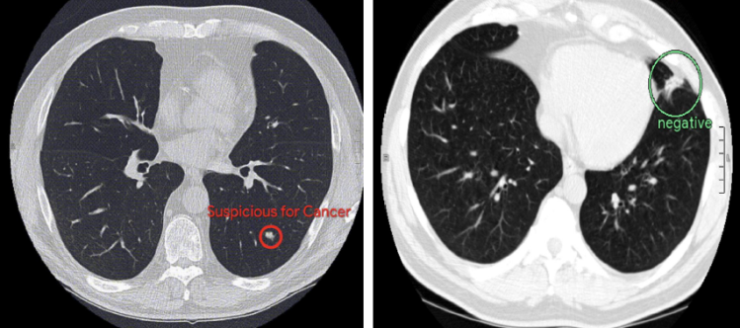
Example: Medical Diagnosis (Lung Cancer Diagnosis)
Input (x): CT scan of lung
Output (y): Tumor yes/no, location
Model:Convolutional Neural Network
5%more accurate than doctors.
Also: DeepMind’s AI that can recommend the proper line of treatment for 50 eye diseases with 94% accuracy.
https://news.northwestern.edu/stories/2019/05/artificial-intelligence-system-spots-lung-cancer-before-radiologists/

Slide 40

Example: Translate Between Languages
Input (x): Sentence in Chinese
Output (y): Sentence in English
Model: Seq2Seq, recurrent
https://arxiv.org/abs/1409.3215

Slide 41

Example: Trajectory Prediction
Input (x): past trajectory, environmental information
Output (y): future trajectory
https://waymo.com/, https://comma.ai/, https://www.tesla.com/autopilot

Slide 42


Example: Text Generation – OpenAI’s GPT-3
Input (x): Start of text
Output (y): Rest of text
Model: Transformer

Slide 43

Example: Text Generation – OpenAI’s GPT-3
Input (x): Start of text
Output (y): Rest of text
Model: Transformer

Slide 44

Example: Text Generation – OpenAI’s GPT-3
Input (x): Start of text
Output (y): Rest of text
Model: Transformer

Slide 45



Example: Fluid Dynamics
Input (x): Past velocity fields
Output (y): future velocity field
Model: Equivariant NN

Slide 46
Supervised Machine Learning:
Examples of Model Classes and Algorithms

Slide 47

Example 1: Linear Regression

Slide 48
Example 1: Linear Regression

Slide 49

Example 1: Linear Regression

Slide 50
Example 1: Linear Regression

Slide 51




Example 1: Linear Regression

Slide 52


Example 1: Linear Regression

Slide 53
Example 1: Linear Regression

Slide 54



Example 1: Linear Regression
(if P full rank, else need to solve for W in )
Notes:
assuming P has full rank. Otherwise need to solve the equation WPP^T = QP^T
wikipedia

Slide 55

Example 1: Linear Regression
(if P full rank, else need to solve for W in )
However, linear function class cannot approximate complicated functions f
Need a more expressive function class
Notes:
assuming P has full rank. Otherwise need to solve the equation WPP^T = QP^T
wikipedia

Slide 56












Example 2: Logistic Regression
Notes:
assuming P has full rank. Otherwise need to solve the equation WPP^T = QP^T
wikipedia

Slide 57






Example 2: Logistic Regression
Notes:
assuming P has full rank. Otherwise need to solve the equation WPP^T = QP^T
wikipedia

Slide 58







Example 2: Logistic Regression
Notes:
assuming P has full rank. Otherwise need to solve the equation WPP^T = QP^T
wikipedia

Slide 59




Example 2: Logistic Regression
Notes:
assuming P has full rank. Otherwise need to solve the equation WPP^T = QP^T
wikipedia

Slide 60
Example 2: Logistic Regression
Notes:
assuming P has full rank. Otherwise need to solve the equation WPP^T = QP^T
wikipedia

Slide 61














Example 2: Logistic Regression
Notes:
assuming P has full rank. Otherwise need to solve the equation WPP^T = QP^T
wikipedia

Slide 62
Example 2: Logistic Regression
This model class is still not that expressive. Many functions it cannot fit well.
Notes:
assuming P has full rank. Otherwise need to solve the equation WPP^T = QP^T
wikipedia

Slide 63




Idea: Stack Multiple Linear Layers

Slide 64




Idea: Stack Multiple Linear Layers

Slide 65




Idea: Stack Multiple Linear Layers

Slide 66






Idea: Stack Multiple Linear Layers

Slide 67












Example 3: Neural Network (MLP)
Class of Functions:
Where
Without σ ⇒ a product of matrices ⇒ f_{Ө} linear
σ is non-linear function applied component-wise:
Notes:
assuming P has full rank. Otherwise need to solve the equation WPP^T = QP^T

Slide 68

Example 3: Neural Network (MLP)
Very flexible approximators!
No closed form solution for finding best fit
Notes:
IBM

Slide 69








Example 3: Neural Network (MLP)
Notes:
http://rasbt.github.io/mlxtend/user_guide/general_concepts/gradient-optimization/
https://ml-cheatsheet.readthedocs.io/en/latest/gradient_descent.html

Slide 70

Example 3: Neural Network (MLP)
Potential Issues:
No guarantee the local minimum found through gradient descent is a global minimum with respect to either the sample S or true function f.
Overfitting: The function class F is too big. We may precisely fit the training sample S without finding the true function f
Need a lot of parameters Ө
Need a large dataset S
Considering classes F with geometric indutive biases can help address these issues.

Slide 71

Artifical Neural Networks Perspective

Slide 72

artificial neuron
input features
weights
x₁
sum
⌃
non-linearity
x₂
output feature
x_{M}

Slide 73

multiple neurons form a layer
input
features
weights
sums
⌃
non-linearities
x₁
⌃
output features
x₂
⌃
x_{M}

Slide 74

multiple neurons form a layer
input features
weights
x
non- sums linearities
⌃
1
x₂
⌃
⌃
x_{M}

Slide 75

multiple layers form a network
input
features
hidden features
weights
weights
x
non- sums linearities
⌃
non- sums linearities
⌃
1
x₂
⌃
⌃
⌃
⌃
x_{M}

Slide 76

input features
weights
x₁
sum
non-linearity
x₂
output feature
⌃
x_{M}
artificial neuron: weighted sum and non-linearity
bias
input features
s = w₀ + w₁x₁ + w₂x₂ + · · · + w_{M} x_{M} = w^{T}x
sum weights
h = σ(s)
output feature
non-linearity
sum

Slide 77

input features
weights _{sum}
⌃
non-linearities
x₁
⌃
output features
x
2
⌃
x_{M}
layer: parallelized weighted sum and non-linearity
one sum
per weight vector
s_{j} = w^{T}x
s = W^{T}x
vector of sums from weight matrix
j
h = σ(s)

Slide 78
Backpropogation

Slide 79


Slide 80
Example 3: Neural Network (MLP)
Notes:
http://rasbt.github.io/mlxtend/user_guide/general_concepts/gradient-optimization/
https://ml-cheatsheet.readthedocs.io/en/latest/gradient_descent.html

Slide 81






Slide 82









Slide 83




Slide 84




Slide 85




Slide 86












Slide 87












Slide 88

As we add more layers the computational savings is greater
Backprop is a tree-based caching algorithms for more efficiently computing many chain-rule-based derivatives

